Slide 1
Georgia Studies
Unit 7: Early 20th Century Georgia
Lesson 2: World War II
Study Presentation

Slide 2
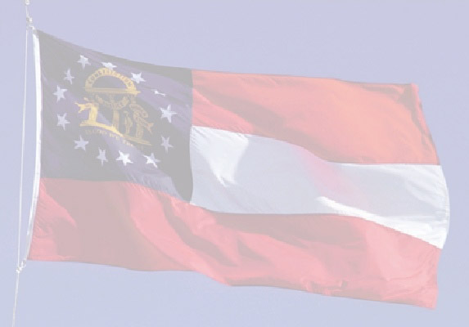
Lesson 2: World War II
ESSENTIAL QUESTION:
How do acts of aggression influence public sentiment toward conflict?
How can wars create economic opportunities?
How do atrocities against ethnic or cultural groups impact other peoples and regions?

Slide 3
Increasing Tensions
Dictator: individual who ruled a country through military strength
Country | Leader | Quick Facts
Japan | Emperor Hirohito | Attacked China seeking raw materials
Italy | Mussolini | Attacked Ethiopia and Albania
Germany | Adolf Hitler | Nazi leader; began rebuilding military forces, persecuting Jews, and silencing opponents
Soviet Union | Josef Stalin | Built up industry and military, forced peasants into collective farms, eliminated opponents

Slide 4
World War II Begins
1938: Hitler’s Germany attacks France to “take back” land lost in WWI (Rhineland)
Sent troops to take over Austria, Czechoslovakia, and Poland
Great Britain and France declared war
Soviet Union invaded nearby countries and agreed to split Poland with Germany
By 1940, Hitler controlled Denmark, Norway, Holland, Belgium, Luxembourg and a large part of France and began bombing Great Britain

Slide 5
A Neutral United States
Most Americans did not want to get involved in the war, but Roosevelt wanted to help Britain
Hitler turned on Stalin in 1941 and invaded the Soviet Union
Lend-lease: policy to lend or lease (rent) weapons to Great Britain and the Soviet Union
American ships began escorting British ships in convoys

Slide 6
“A Day that Will Live in Infamy”
President Roosevelt stopped exports to Japan to protest its expansion into other countries
Exports of oil, airplanes, aviation gasoline and metals were stopped
The Japanese attacked the U.S. Navy fleet at Pearl Harbor, Hawaii on Dec. 7, 1941
Japan hoped to destroy the fleet giving them control of the Pacific Ocean
The USA declared war on Japan
Allied Powers: USA, Great Britain, Soviet Union
Axis Powers: Germany, Italy, Japan

Slide 7
American Military Forces
Millions of Americans enlisted after the attack on Pearl Harbor
330,000 women joined – could not serve in combat roles
Segregation in the military kept African American and white service men in different units
Tuskegee Airmen: famous African American flyers of the Army Air Force
After the war, women and African Americans did not want to go back to the kind of life they had before the war

Slide 8
The War in Europe
1942-1943: British and American troops won control of Africa
1943: Mussolini overthrown and Italy joined the Allies
American general Dwight D. Eisenhower coordinated plan to recapture Europe
D-Day: June 6, 1944 – Allied forces land in northern France at Normandy
Early 1945: Germans pushed out of France
April 1945: Soviet and American troops meet and Germany surrenders – Hitler commits suicide

Slide 9
The Holocaust
The Holocaust: name given to the Nazi plan to kill all Jewish people, and others deemed “undesirable”
Auschwitz, Buckenwald, Dachau, Treblinka, Bergen-Belsen infamous concentration camps where Jews and others were executed
6 million Jewish people killed in the Holocaust; approximately 5 million other “undesirables” also killed

Slide 10
Roosevelt’s Ties to GA
President Roosevelt visited Georgia often at his “Little White House” in Warm Springs
His polio symptoms were eased in the mineral springs
April 24, 1945: President Roosevelt died at Warm Springs
Millions of Georgians and Americans mourned
Vice President Harry Truman became president

Slide 11
The War in the Pacific
1942: Japan expanded its territory throughout the Asian Pacific region
1945: Allied forces began to retake Japanese controlled lands
Japan refused to surrender
President Truman authorized the use of atomic bombs to force Japan’s surrender
Enola Gay: plane that dropped first atomic bomb on Hiroshima, Japan (between 70,000 and 100,000 people died)
Japan surrendered after a second atomic bomb dropped on Nagasaki (killed approximately 40,000 people and injured 40,000 additional people)
August 15, 1945 – Japan surrenders ending WWII
Over 50 million people died in the war

Slide 12
Georgia During World War II
320,000 Georgians joined the armed forces – over 7,000 killed
Military bases (such as Fort Benning) were built in the state which improved the economy
Farmers grew needed crops – income tripled for the average farmer
Limits were put on the consumption of goods such as gasoline, meat, butter, and sugar (rationing)
Students were encouraged to buy war bonds and defense stamps to pay for the war
POW (prisoner of war) camps were made in Georgia at some military bases
Brunswick and Savannah Shipyards supplied ships for the US Navy and Bell Aircraft helped to create planes.

Slide 13
Richard Russell and Carl Vinson
Richard Russell – US Senator from GA; worked to bring over a dozen military bases to GA. These military bases helped to bring jobs and resources to the state.
Carl Vinson – US Representative from GA; helped to build the US Navy in the years leading up to World War II. Vinson wrote many bills that expanded the US Navy and helped to supply our allies during the Lend-Lease Act and to overcome the damages of Pearl Harbor. Many of the ships were built at the Savannah and Brunswick shipyards.

