Slide 1
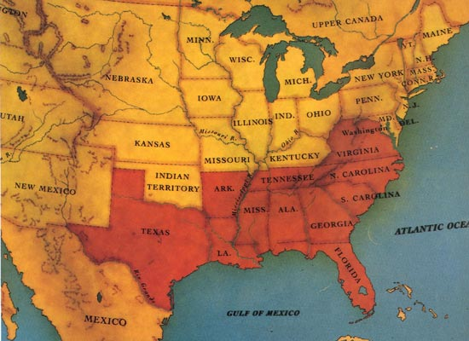
Election of 1860 and Alexander Stephens
The Confederate States of America: South Carolina led the way out of the Union on December 20, 1860, and by March 1861, six more states, outraged over Lincoln's election to the presidency and emboldened by South Carolina's example, also seceded: Mississippi, Florida, Alabama, Georgia, Louisiana, and Texas. After the bombardment of Fort Sumter and Lincoln's call for troops to put down the rebellion in April, Virginia, Arkansas, Tennessee, and North Carolina followed suit, bringing the number of states in the new Confederacy to eleven.

Slide 2
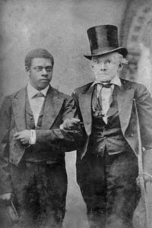
Alexander Stephens
Elected to the General Assembly in 1836
Spoke out against Georgia seceding from the Union.
His fellow law makers criticized him for this.
He eventually became the vice president of the CSA in
After the war, he was imprisoned for 5 months in Boston.
He was later elected to U.S. Senate, Georgia House of Reps, and Georgia Governor.

Slide 3
The War Begins: Southern Secession
April 10, 1861, Major General P.G.T. Beauregard leads bombardment of Fort Sumter, in Charleston Harbor
Federal troops and laborers inside Fort Sumter surrender on April 13
Arkansas, North Carolina, Tennessee, and Virginia secede from the Union
President Abraham Lincoln calls for 75,000 troops to put down the rebellion and protect Washington

Slide 4
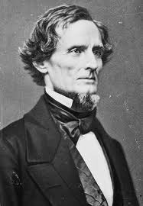
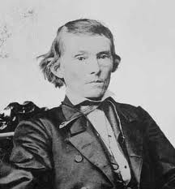
CSA
President-Jefferson Davis
Vice President-Alexander Stephens

Slide 5
Resources – North and South Industry v. Agriculture
North had more people from which to create and resupply armies
North had more factories, better railroad system, and most of the nation’s food growing farms and wealth
South had more experienced military leaders, and were highly motivated to defend their familiar homeland and to win independence.
Most Southern farms were used to grow cash crops (cotton, etc.), so trade (cotton for weapons/supplies) was very important to the South.

Slide 6
Freeing the Slaves
President Abraham Lincoln issued the Emancipation Proclamation on September 22, 1862
Document gave the Southern Confederacy a choice: Quit the war and keep slavery alive or keep fighting and slaves would be forever free
Deadline was January 1, 1863
The Confederate leaders continued the war and the slaves were declared free by the United States government in 1863

Slide 7
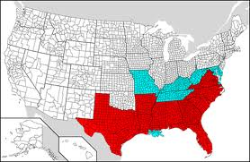
"That on the 1st day of January, A.D. 1863, all persons held as slaves within any State or designated part of a State the people whereof shall then be in rebellion against the United States shall be then, thenceforward, and forever free…”
According to the map, what does this mean?
Hint: All states that are shaded are slave holding states. The states that are in red are part of the CSA.

Slide 8
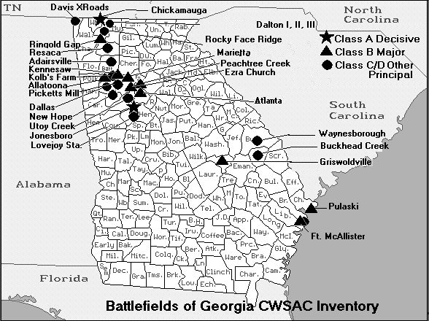
Battle of Chickamauga

Slide 9
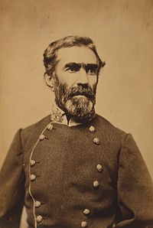
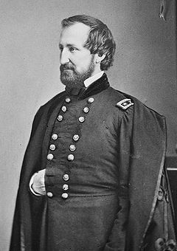
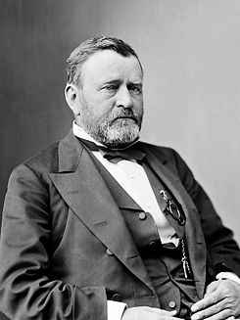
What was the Battle of Chickamauga?
When did it occur and why was it so important?
What happened?
What was the outcome?
Biggest battle fought in Georgia
September 19, 1863, Union troops moved just south of Chattanooga. This was a major rail junction and served as a gateway to the deep south. Lasted for three days.
Confederates, led by Braxton Bragg, caused the Union troops, led by William Rosecrans, to retreat. They chose not to follow up on the fleeing Union troops.
Two months later, Ulysses Grant came and captured Chattanooga. Confederate troops retreated just south of Dalton, GA

Slide 10
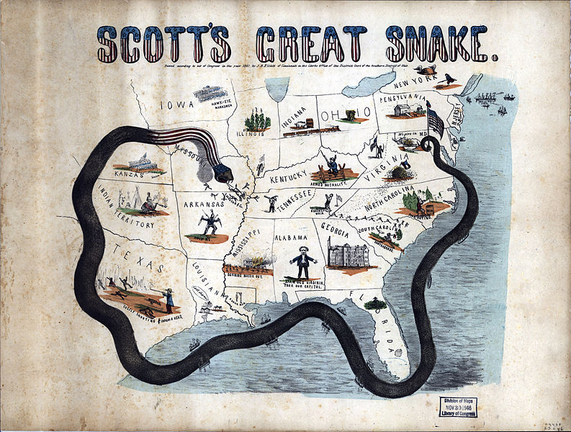
Union Blockade of the Georgia Coast
What is a blockade?
How did the Union use the blockade against the CSA?
What are blockade runners?
When ships are strategically placed along the coast to hinder export and import efforts. How does this hurt the Confederacy?
Union vessels patrolled the southern coast and ran off any ships trying to get in or out of the south.
Private ships that were willing to take risk. They sped and slipped through gaps in the blockade vessel line.

Slide 11
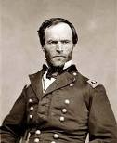
William T. Sherman Union General
What was Sherman’s Atlanta Campaign?
What was the March to the Sea?
http://quantumtour.com/entity/mcallister/video/1/
Sherman led the Union army into North Georgia.
Was engaged in battle with Confederate troops for one month.
Confederate’s fled toward Atlanta and finally evacuated Atlanta.
Sherman’s army took control of the railroads and factories. They set fire to Atlanta on November 15, 1864. His army ripped up railroad tracks and tied them around trees-Sherman’s neckties
Sherman’s army march south from ATL to Savannah burning everything.
This march took 2 months.
Sherman did not burn Savannah but gave it to Lincoln as a Christmas present.

Slide 12
Sherman’s Atlanta Campaign
Late Spring/Early Summer 1864: William Tecumseh Sherman’s Union Army fought series of battles against Joseph E. Johnston’s Confederate Army in an attempt to capture/destroy the important Confederate rail and supply center of Atlanta
Confederates continued to retreat further southward into Georgia
June 27, 1864: Sherman attacked Johnston at Kennesaw Mountain; Sherman was unable to defeat the Confederate troops but continued toward Atlanta
July 1864: Confederate General John Bell Hood replaced Johnston, battled Sherman, then concentrated defenses in Atlanta

Slide 13
The Battle of Atlanta
Sherman surrounded the city and laid siege
Hood wanted to lure Sherman into the city to fight, but that didn’t work
Fighting continued during July and August 1864
Hood and Atlanta’s citizens finally evacuated the city on September 1, 1864
Sherman burns the city in mid-November then begins his march toward Savannah and the sea. The Army then burned all but about 400 of Atlanta’s buildings (approximately 90% of Atlanta was burned/destroyed)

Slide 14
Sherman’s March to the Sea
Part of the Lay Waste Strategy - Sherman’s Union army destroys everything in its path, 300 miles from Atlanta to Savannah
A sixty mile-wide area is burned, destroyed, and ruined during a two-month period
Estimated losses exceeded $100 million
Captured, but did not burn, Savannah in December 1864
Union troops loaded and shipped $28 million worth of cotton, stored in Savannah, to the North

Slide 15
The Civil War Ends
January 13, 1865: Fort Fisher in North Carolina captured;the last Confederate blockade-running port
General Robert E. Lee’s Army of Virginia cannot defeat Union General Ulysses S. Grant at Petersburg; he surrenders his army at Appomattox Courthouse on April 9, 1865
Confederate President Jefferson Davis and Vice President Alexander Stephens (from GA) flee and are eventually captured

Slide 16
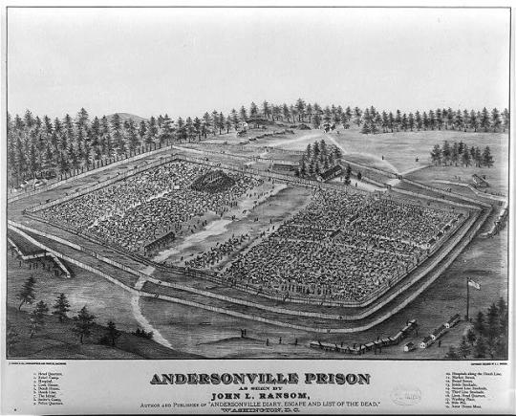
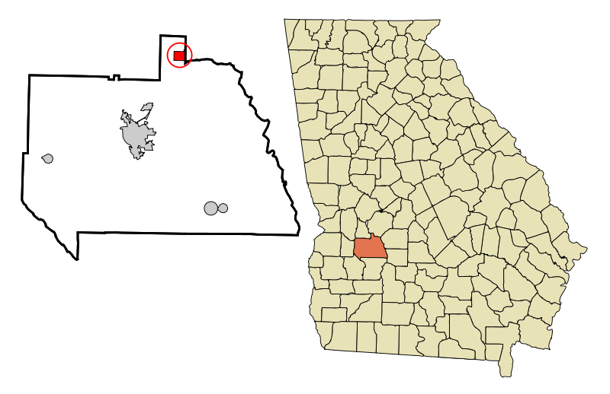
Civil War Prisons
Both North and South had prisons for captured soldiers; thousands of men on both sides died in these prisons
Andersonville Prison, in southwest Georgia, was overcrowded, and offered poor food, contaminated water, and poor sanitation; 13,700 Union soldiers are buried there
Captain Henry Wirtz, Andersonville Prison commander, was later hanged for “excessive cruelty”
Andersonville is now home to the National Prisoner of War Museum

Slide 17
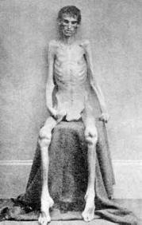
Andersonville
What was Andersonville?
What was the purpose of this prison?
Andersonville was a Confederate prison.
When Union soldiers were captured, they were sent to prisons as POWs.
The prisons were very dirty and unsanitary.
Lack of clean water, food, and medical supplies led to untold numbers of death while imprisoned.
Andersonville operated for 13 months. Almost 13,000 Union soldiers died in Andersonville prison

Slide 18
The Aftermath
620,000 people died during the war; about two-thirds died from diseases, wounds, or military prison hardships
In order to reenter the United States the South would have to endure political, emotional, and physical reconstruction
Healing of emotional wounds took far longer than the war itself
The North or the South would never be the same again

